Slide 1
BigBlue
PROJECT 1
By
Lama Katerina
Polydoros Manos
Mamatsopoulos Themis

Slide 2
The subject
Amazon Sales
Between 01/01/2020 and 29/12/2024
Which countries are the sales deployed ?
What is the distribution of each country to Sales
How are orders dispersed into countries
Product categories
How are they ranked through sales?
How are orders distributed trough categories
Categorized sales per Country

Slide 3
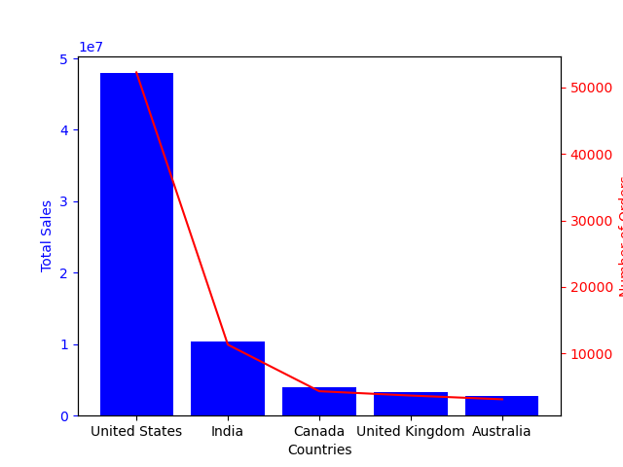
Sales per Country (figures)
County | Total Amount | Number of orders
United States | $47,935,105.93 | 52265
India | $10,383,463.02 | 11310
Canada | $3,924,934.67 | 4306
United Kingdom | $3,316,230.45 | 3654
Australia | $2,812,943.03 | 3093

Slide 4
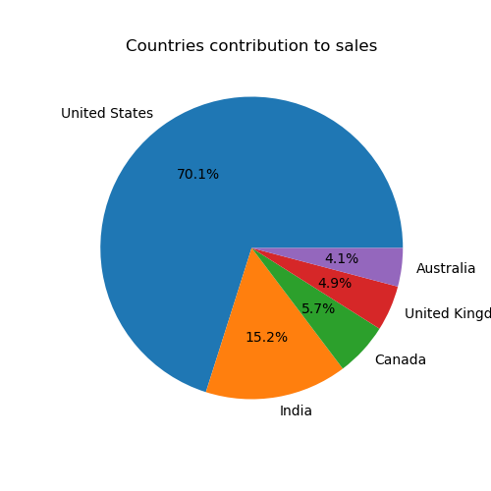

Countries contribution to sales (pie)

Slide 5
United States Sales figures

Slide 6
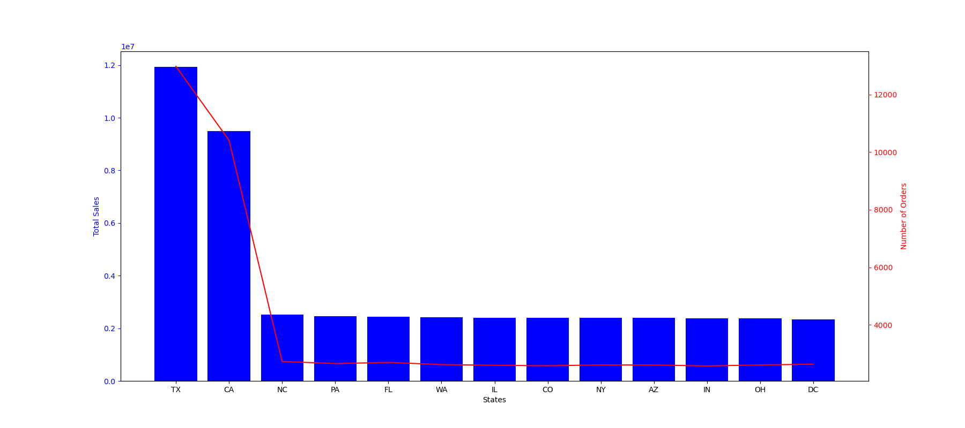
United States Sales view

Slide 7
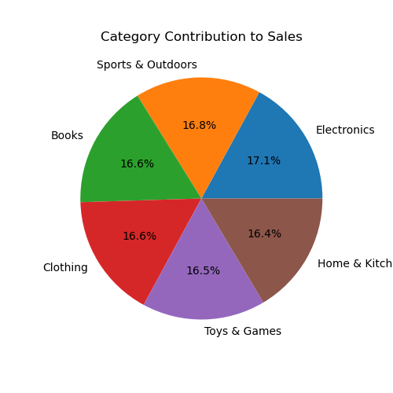
Sales per Product Category

Slide 8
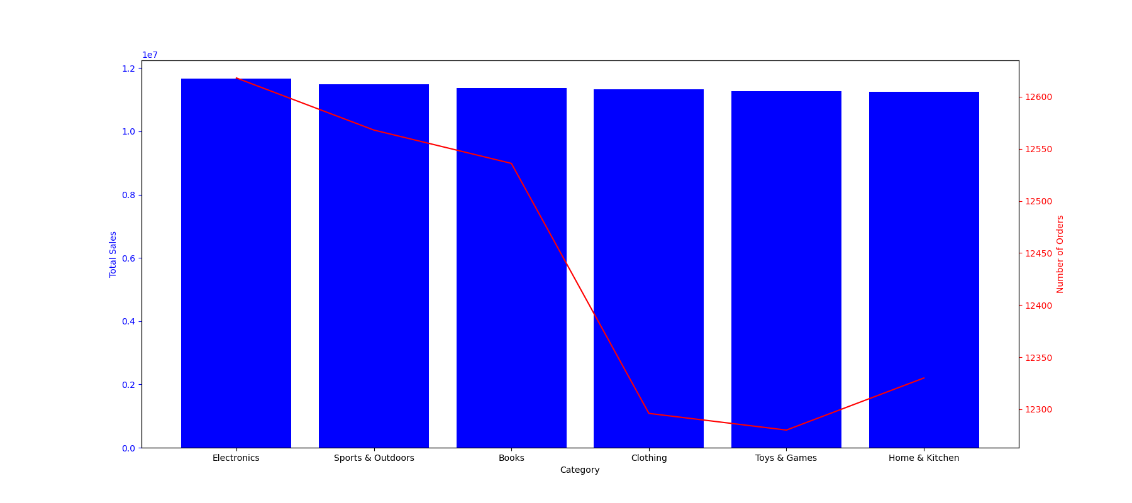
Sales per Category

Slide 9
What’s NEXT
What are the lowest sales?
Per Country?
Per Category?
Category per Country?
What is the best strategy to follow?
Empower further our strong countries / categories
Boost sales in weak countries / categories
Target new countries with old or new product categories
A further analysis should be appointed
For further insights extraction
For data-driven decisions

Slide 10
RFM analysis attempt failed
More completed Data needed
Attempt to perform an RFM analysis failed
Due to Data limitations
70% of customers had only one order
Impossible to distribute in bins
Frequency analysis failed
RFM analysis
rather inappropriate for Amazon orders
Only if additional data demonstrate more than one purchase per customer

Slide 11
Thank YOU
FOR YOUR ATTENTION

